Slide 1
Global Suicide Prevention
By: Jiajun Kuang,Jiayuan Li, Yanmei Lin , Xuming Shi
CIS 9650- Programing for Analytics MNSA
Zicklin School of Business- Baruch College CUNY
Group 7
Prof. Ali Koc
Fall 2019

Slide 2
Dataset
Suicide Rates Overview
https://www.kaggle.com/russellyates88/suicide-rates-overview-1985-to-2016/data#
World Happiness Report
https://www.kaggle.com/unsdsn/world-happiness#2015.csv

Slide 3
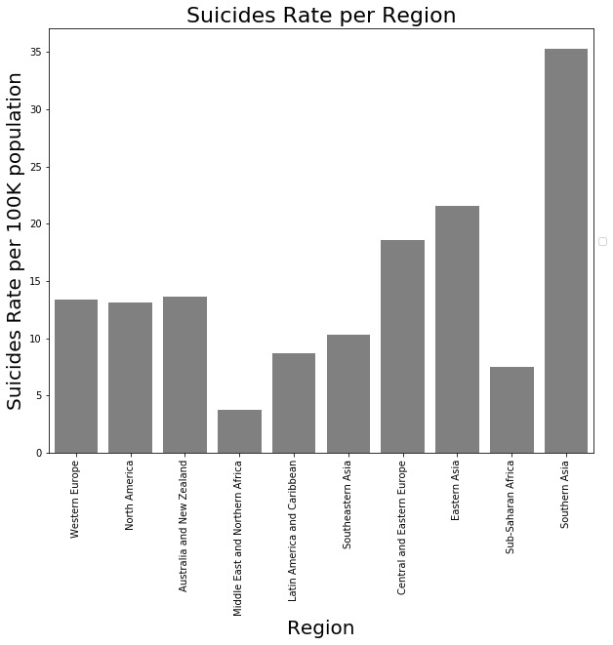
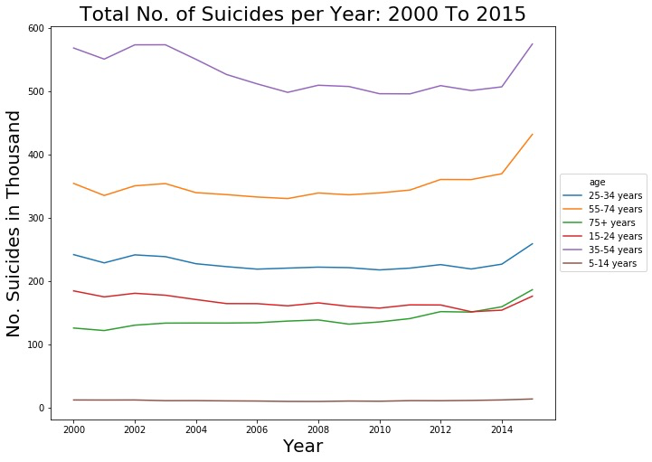
Problem
Notes:
Break down -> region level
Suicide rate increased

Slide 4
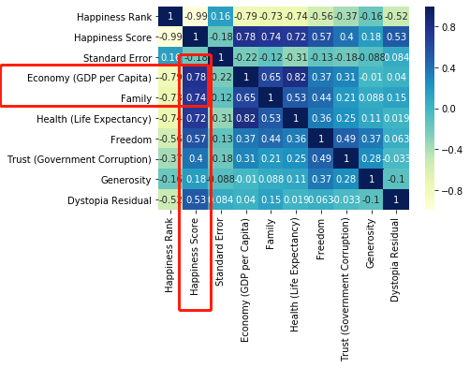
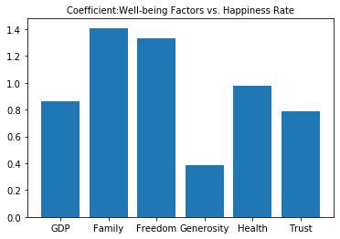
The key drivers
Correlation
What factors?
Built multiple-regression model
GDP correlates with Happiness score
Family well-being is the most significant factor that impacts the happiness rate
Coefficient
Notes:
Connect the happiness and suicide dataset
Investigate the happiness data, find out the factors that have strongest attribution on the change of happy rate
Use those number to get an idea, and provide recommendation for gov, where to invest in order to lift happiness rate and potential decrease suicide rate

Slide 5
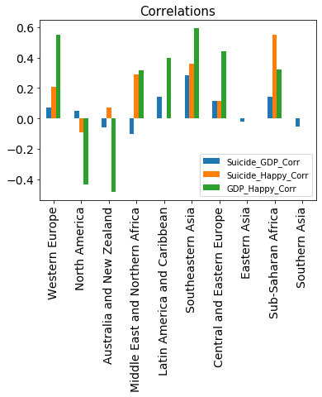
Need to dive deeper
Every Region differs
In some regions, GDP positively correlated with Happiness
North America vs. Southeastern Asia
In other region, we need to consider other factors
Next step: how to use our tool to generate recommendations?
Notes:
Compare the correlations by regions…
Trends are totally different
North America: more developed region
Southeastern asia: GDP positively correlated

Slide 6
Application
Model:
Input: country
Output:
Predicted group that mostly like to commit suicide
Strategy to mitigate suicide rate:
Improve Economy OR Happiness?
GDP, Family, Health (lift expectation), Freedom, Trust (government corruption), Generosity, Dystopia Residual

